Slide 1

Business Case 5 Retail Analysis
MASTER DEGREE PROGRAM IN DATA SCIENCE
AND ADVANCED ANALYTICS
GROUP D
Débora Santos : 20200748
Pedro Henrique Medeiros : 20200748
Rebeca Pinheiro: 20201096

Slide 2
Project Objectives
Understand each Point-of-Sale characteristics (top products sold, market share and product co-occurrences)
Points of sales clustering divided by value and product preference
Units’ products forecast 6 weeks: one split by product and by point-of-sale and another one total by-product.

Slide 3
Sales Analysis
• Sales show seasonality/oscillations between months in terms of volumes but in values, it is well aligned
• Quarters 1 and 4 have the highest volumes
• Sunday is the day with the lowest sales volume
• The year with the highest sale were 2018 with more than 86B in sales and quantity more than 52B.
• Product family with a higher percentage in sales is product family 2 (19% in total which correspond to 61B in sales)
• POS_292 is the most representative in sales - 2B in sales (12% of the total)
• ProductName_ID is 2802 has the most purchases - 19B on sales (18,96% in GT)
• ProductCategory_ID 178 is by far the most frequent - 239B in sales (82% in total)

Slide 4
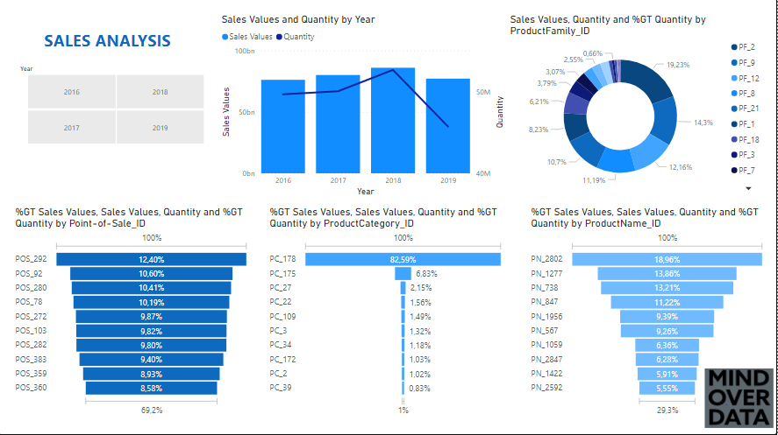

Slide 5
Clusters
Our final solution was able to detect 3 segments:
Valuable: stores with higher sales volume with average price between Bulk and Premium
Bulk: stores with average sales volume of products with lower price
Premium: stores that sell the products at the highest prices, but with the lowest sales volumes
K-means algorithm used for clustering
Inertia plot, average silhouette plot, Davies-Bouldin plot, Silhouette plot and t-SNE plot to visualize and evaluate the results

Slide 6
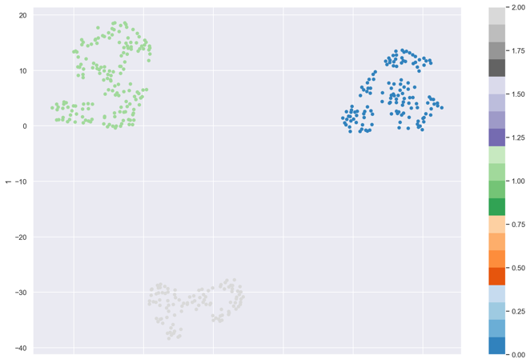
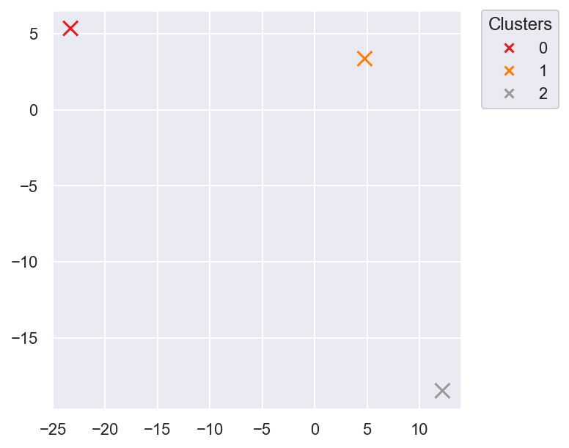
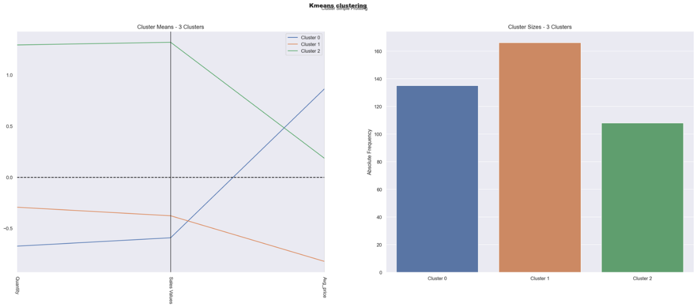
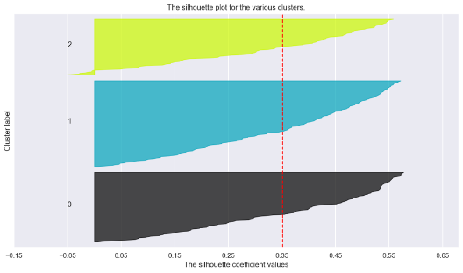
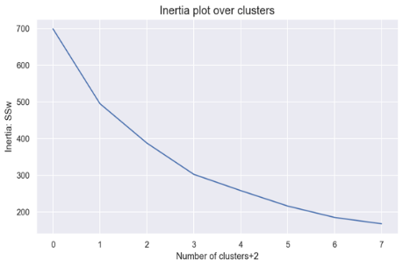
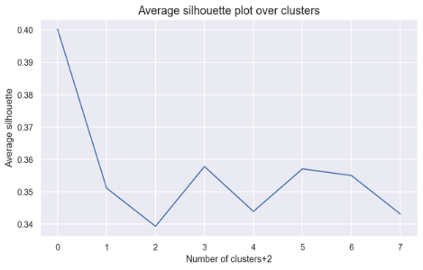
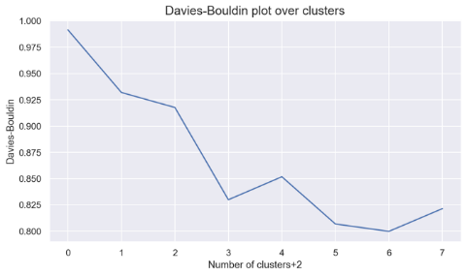
Clusters

Slide 7
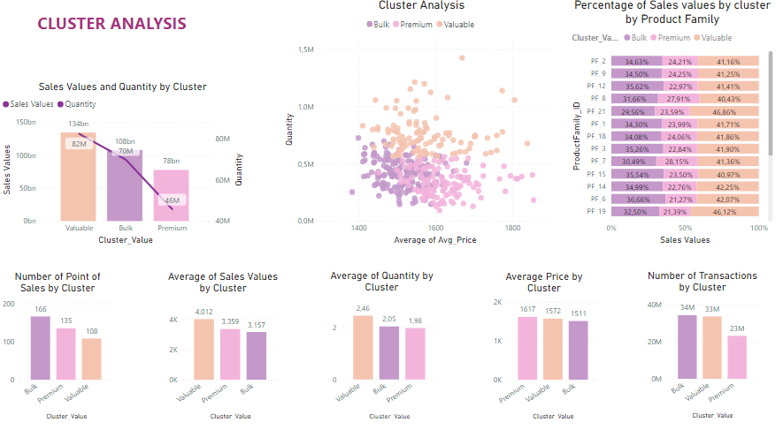

Slide 8
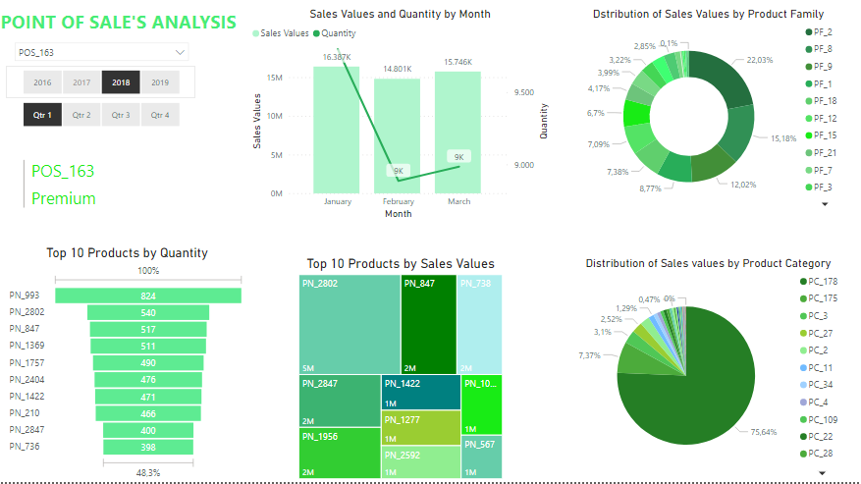
The category 178 represents more than 75% of sales
More than 50% of sales are concentrated in 4 families: 2,9, 8 and 1, with family 8 having the highest average selling price in general.
The best-selling product has more than 15% of sales and the tenth-best selling product represents 50% compared to the first-best selling product

Slide 9
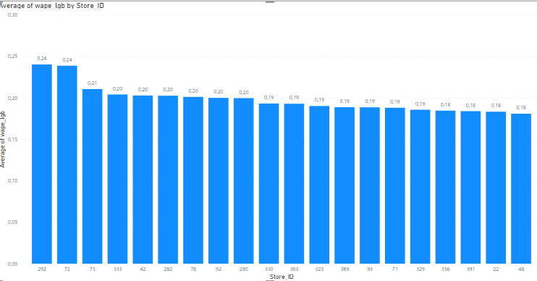
Demand Forescast
Feature Engineering
Model LGBMRegressor
Evaluation: MSE and WAPE

Slide 10
Thank You!

